Slide 1

DOMAIN NAME:DEEP LEARNING
TITLE NAME: RECYCLABLE WASTE CLASSIFICATION USING DEEP LEARNING
SUPERVISOR NAME:
PRESENTED BY,
A.AGNESMARYLAVANYA(811721243004)
G.BRINDHA(811721243012)
D.SAHANA SRI(811721243046)
R.VINODHA(811721243062)
Mr.Joshua Issac., M.E
AP/AI.

Slide 2
OBJECTIVE
To Develop a waste classification system that achieves high accuracy in identifying and categorizing different types of waste items. Create an efficient system capable of processing waste images quickly, enabling real-time or image classification. Design a system that can scale to handle a large number of waste items and accommodate future expansion or changes in the dataset.

Slide 3
PROBLEM DEFINITION: EXISTING SYSTEM
The traditional method of waste classification involves manual sorting and visual inspection by human workers.
Neural networks, including feedforward neural networks, convolutional neural networks (CNNs), and recurrent neural networks (RNNs), have gained prominence in waste classification tasks due to their ability to automatically learn hierarchical features from raw data. CNNs, in particular, have shown remarkable performance in image-based waste classification tasks.

Slide 4
PROPOSED SYSTEM
The proposed system for smart waste classification using VGG16 CNN involves training a deep learning model using the VGG16 architecture to classify different types of waste based on images. The VGG16 architecture is a popular CNN architecture that has been shown to achieve high accuracy in image classification tasks. And also detect the objects from real time camera using YOLO algorithm and finally classify the object whether it is degradable or not.

Slide 5
LITERATURE SURVEY
S.No | Paper Title | Author Name | Year | Techniques | Merits
1 | Waste management using machine learning and deep learning algorithms | Sami | 2023 | Machine Learning, Deep Learning | Effective waste classification and prediction
2 | Illegal trash thrower detection based on hogsvm for a real-time monitoring system | Sarker | 2022 | HOG-SVM (Histogram of Oriented Gradients - Support Vector Machine) | Real-time detection of illegal trash dumping

Slide 6
 | PAPER TITLE | AUTHOR NAME | YEAR PUBLISHED | TECHNIQUE USED | MERITS | DEMERITS
3 | Deep learning-based waste detection in natural and urban environments | Majchrowska | 2022 | Deep Learning | High accuracy in waste detection across different environments | Requires large datasets for effective training
4 | Solid waste image classification using deep convolutional neural network | Nnamoko | 2022 | Deep Convolutional Neural Network (CNN) | Improved image classification accuracy for solid waste | Model complexity can lead to slower processing speeds

Slide 7
 | PAPER TITLE | AUTHOR NAME | YEAR PUBLISHED | TECHNIQUE USED | MERIT | DEMERIT
5 | Deep convolutional neural networks object detector for real-time waste identification | Melinte | 2023 | Deep Convolutional Neural Network (CNN) | Real-time waste identification capability | Requires significant computational resources for real-time performance

Slide 8
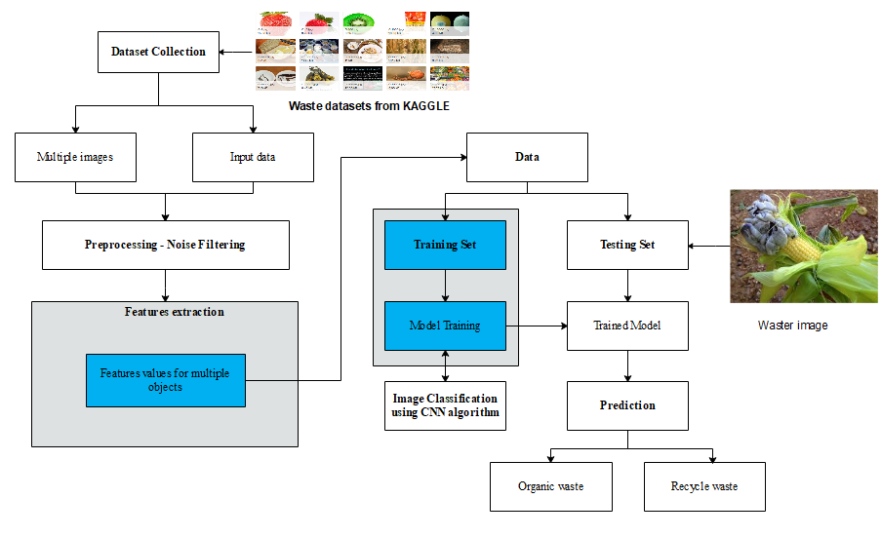
SYSTEM ARCHITECTURE

Slide 9
SYSTEM AND SOFTWARE SPECIFICATIONS
SYSTEM REQUIREMENTS
Processor : Intel processor
RAM : 1GB
Hard disk : 160 GB
Compact Disk : 650 Mb
Keyboard : Standard keyboard
Monitor : 15 inch color monitor

Slide 10
SYSTEM AND SOFTWARE SPECIFICATIONS
SOFTWARE REQUIREMENTS
Operating system : Windows OS
Front End : PYTHON
IDE : PYCHARM

Slide 11
MODULES
Trash Augmentation
Image Normalization
Model Selection
Model Building
Waste Classification

Slide 12
TRASH AUGMENTATION
Dataset acquisition refers to the process of obtaining data for use in various applications, such as machine learning, data analysis, and research.
In this module, we can input the waste datasets that are collected from KAGGLE web sources.
It contains the various waste details as in image format.

Slide 13
KEY COMPONENTS
Dataset Acquisition: Collect waste image datasets, e.g., from Kaggle.
Dataset Diversity: Ensure the dataset includes various types of recyclable and non-recyclable waste.
Blur Effects: Use motion blur or Gaussian blur to mimic motion or low-quality images.

Slide 14
IMAGE NORMALIZATION
Image preprocessing refers to the process of preparing digital images for further analysis or processing, such as computer vision or image recognition tasks.
Removing any unwanted noise or artifacts from the image.
Adjusting the image brightness and contrast to ensure consistent image quality.

Slide 15
KEY COMPONENTS
Noise Removal: Eliminate unwanted noise and artifacts from images.
Brightness and Contrast Adjustment: Maintain consistent quality.
Image Resizing: Standardize dimensions.
Image Cropping: Remove unnecessary parts.

Slide 16
MODEL SELECTION
In this module, we can construct the VGG16 model and YOLO model for train the images for both real time and image acquisition
VGG16 has a large effective receptive field, enabling it to capture information from a significant portion of the input image.
Rectified Linear Unit (ReLU) activation functions are used throughout the network, providing faster convergence during training and mitigating the vanishing gradient problem.

Slide 17
KEY COMPONENTS
VGG16: Used for feature extraction and classification; advantages include large receptive fields and fast convergence.
YOLO (YOLOv5): Used for object detection in real-time scenarios.
ReLU Activation: Enhance model training speed and prevent vanishing gradients.

Slide 18
MODEL BUILDING
YOLO models consist of a backbone network followed by detection heads.
The backbone network extracts features from the input image, while the detection heads predict bounding boxes and class probabilities.
The backbone with convolutional blocks, each comprising convolutional layers followed by batch normalization and ReLU activation.

Slide 19
KEY COMPONENTS
Architecture Definition: Build backbone networks (e.g., convolutional blocks with batch normalization and ReLU).
Detection Heads: Predict bounding boxes and class probabilities.
Downsampling Layers: Reduce spatial dimensions during feature extraction.

Slide 20
WASTE CLASSIFICATION
Evaluate the model's performance on the validation data to avoid overfitting and to ensure that the model is generalizing well to new data.
Based on the validation performance, adjust the model architecture, hyperparameters, or training procedure to improve the model's performance.
Finally, evaluate the model's performance on a separate test set to obtain its performance on unlabeled data.

Slide 21
KEY COMPONENTS
Validation: Test model performance to avoid overfitting.
Optimization: Fine-tune architecture, hyperparameters, and training procedures.
Testing: Evaluate on separate datasets for unbiased performance measurement.

Slide 22
ADVANTAGES
Improved accuracy: Deep learning enhances waste classification accuracy significantly.
Automation: AI automates waste sorting, boosts efficiency.
Scalability: System scales for industrial waste management efficiency.
Sorting Process :Automates Sorting Process Efficiently Always.
Cost Effective:Optimizes Waste Management Cost Effectively.

Slide 23
APPLICATIONS
Smart Waste Bin Monitoring :Monitor waste bins in real-time remotely.
Recycling Sorting System:AI-powered recycling sorting and separation.
Industrial Waste Recovery:Maximize valuable material recovery rates.
Environmental Monitoring Systems:Track waste impact on ecosystems.

Slide 24
CONCLUSION
In conclusion, implementing a YOLO and VGG16-based trash detection system offers a promising solution for automating the identification and classification of trash items within images or real time.
Through the collection,training a YOLO model, we can develop a robust trash detection system capable of accurately identifying and categorizing trash items with high precision.
The deployment of such a system can streamline waste management processes, enhance recycling initiatives, and contribute to the preservation of natural ecosystems.

Slide 25
REFERENCE
Sami, Khan Nasik and Raini Hassan.(2022), Waste management using machine learning and deep learning algorithms, Springer.
Sarker, Nibir, et al.(2023), Illegal trash thrower detection based on hogsvm for a real-time monitoring system, IEEE.
Majchrowska, Sylwia, et al.(2022), Deep learning-based waste detection in natural and urban environments., Research Gate.
Nnamoko, Nonso, Joseph Barrowclough, and Jack Procter(2022), Solid waste image classification using deep convolutional neural network, Springer.
Melinte, Daniel Octavian, Ana-Maria Travediu, and Dan N. Dumitriu(2023), Deep convolutional neural networks object detector for real-time waste identification, IEEE.

Slide 26
THANK YOU!!!

